Slide 1


Introduction to
Robotic Process Automation
CUSTOMER RELATIONSHIP
MANAGEMENT
220701125
KEERTHIGA P
MRS.JINU SOPHIA
B.E and CSE

Slide 2
Abstract
Managing customer relationships often involves repetitive and time-consuming tasks such as entering customer data, updating records, responding to inquiries, and generating reports. These manual processes can lead to delays, errors, and inefficiencies, ultimately impacting customer satisfaction and employee productivity. To address these challenges, this project aims to use UiPath to automate key CRM operations. Automation will streamline data entry and updates, enable quick and accurate report generation, send timely responses to customer inquiries, and synchronize data across systems. The goal is to save time, reduce errors, enhance customer satisfaction, and free up employees to focus on higher-value tasks
Department of Computer Science and Engineering
Rajalakshmi Engineering College ‹#›
Notes:
2

Slide 3
Need for the Proposed System
The proposed system automates CRM tasks like data extraction and entry, ensuring faster, error-free, and real-time updates. It improves efficiency, scales with growth, and enhances customer satisfaction, making it vital for streamlined operations and competitive advantage.
Department of Computer Science and Engineering
Rajalakshmi Engineering College ‹#›
Notes:
3

Slide 4
Advantages of the Proposed System
Time-saving: Automates repetitive tasks, freeing up time for strategic work.
Accuracy: Reduces human errors and ensures consistent, reliable data.
Efficiency: Speeds up data processing and updates in real-time.
Scalability: Handles growing data volumes with ease.
Cost-effective: Lowers operational costs by reducing manual efforts.
Department of Computer Science and Engineering
Rajalakshmi Engineering College ‹#›
Notes:
4

Slide 5
Literature Survey
Paper : Web Automation for Public Service Portals
Advantages:
Discusses the effectiveness of web scraping and RPA for automating interactions with government websites.
Demonstrates the ability to extract large volumes of data efficiently and accurately.
Disadvantages:
Prone to failure when website structures or formats change frequently.
Ethical concerns about data privacy when automating public data portals.
Department of Computer Science and Engineering
Rajalakshmi Engineering College ‹#›
Notes:
5

Slide 6
Main Objective
The main objective of the proposed system is to automate CRM workflows using UiPath, ensuring accurate, efficient, and real-time data handling, reducing manual effort, minimizing errors, and enhancing overall customer service and satisfaction.
Department of Computer Science and Engineering
Rajalakshmi Engineering College ‹#›
Notes:
6

Slide 7



Architecture
Customer Interaction | (Email, Forms, Chat, etc.)
UiPath RPA Bot (Orchestrator)
CRM System (e.g., Salesforce)
Email/Notification (Outlook, Gmail)
Data Storage (Database/CRM)
Report Generation
(Power BI, Excel)
Department of Computer Science and Engineering
Rajalakshmi Engineering College ‹#›
Notes:
7

Slide 8
System Requirements
Hardware:
Dual-core processor
8 GB RAM
100 GB free storage
Stable internet connection
Software:
Windows 10/11
UiPath Studio
Compatible CRM (Salesforce, Microsoft Dynamics, etc.)
SQL database
.NET Framework
Department of Computer Science and Engineering
Rajalakshmi Engineering College ‹#›
Notes:
8

Slide 9
Functional Description
Module 1:Data Processing Module
This module focuses on handling user inputs, retrieving relevant data, and validating it.
Department of Computer Science and Engineering
Rajalakshmi Engineering College ‹#›
Notes:
9

Slide 10
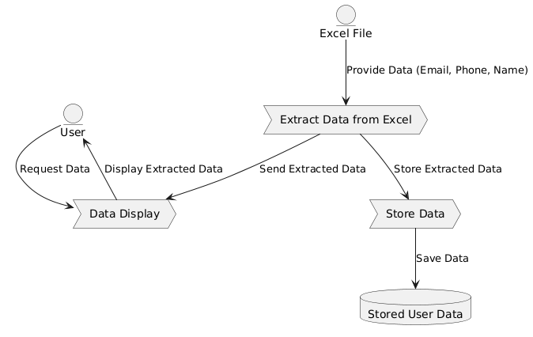
Functional Description
MODULE 2: Data Interaction Module
This module manages user interaction and data storage.
Department of Computer Science and Engineering
Rajalakshmi Engineering College ‹#›
Notes:
9

Slide 11
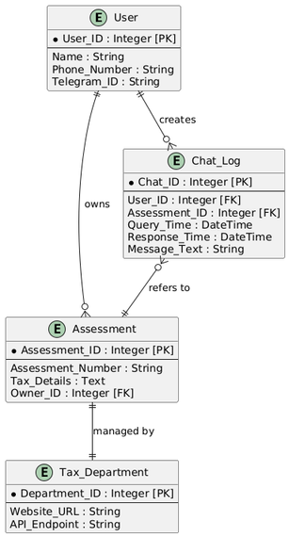
Table Design
Department of Computer Science and Engineering
Rajalakshmi Engineering College ‹#›
Notes:
10

Slide 12
Process Design
Main Process:
Manages the collection, validation, processing, and storage of user data (Name, Phone, Email).
Sub-Processes:
Data Input Collection: Collect user data (Name, Phone, Email).
Data Extraction from Excel: Retrieve data from Excel.
Data Validation: Validate the format of Phone, Email, and ensure Name is provided.
Data Processing: Add or update CRM records.
Data Storage: Save processed data in CRM database.
Report Generation: Create reports summarizing CRM activities.
Department of Computer Science and Engineering
Rajalakshmi Engineering College ‹#›
Notes:
11

Slide 13
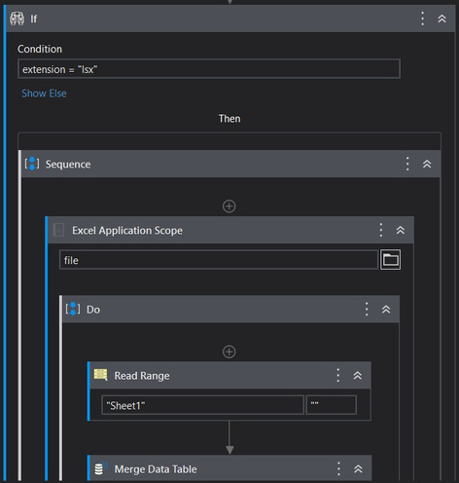
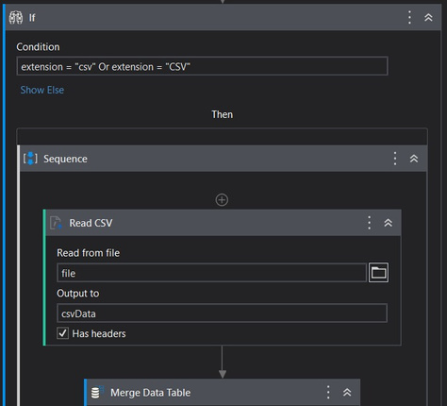
Implementation
Department of Computer Science and Engineering
Rajalakshmi Engineering College ‹#›
Notes:
12

Slide 14
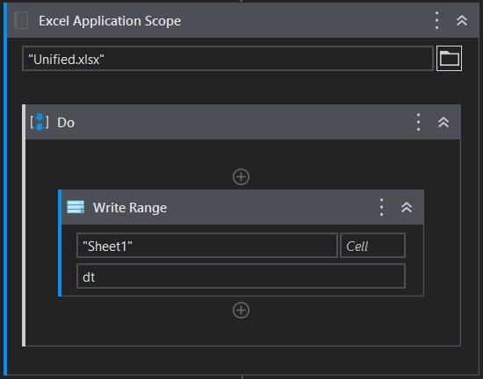
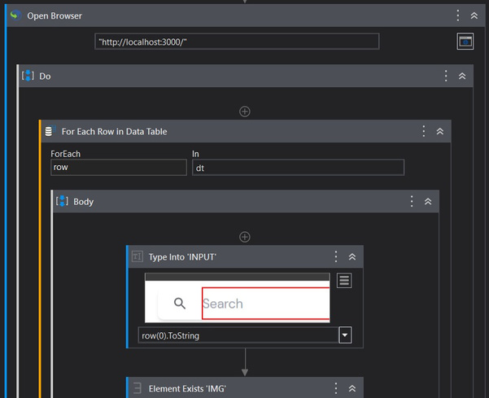
Implementation
Department of Computer Science and Engineering
Rajalakshmi Engineering College ‹#›
Notes:
12

Slide 15
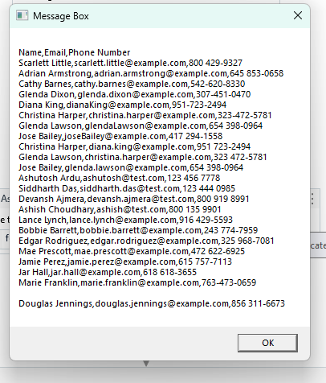

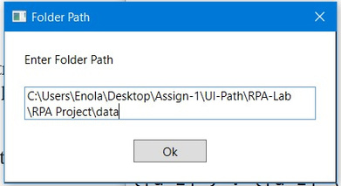
TESTING:
OUTPUT:
Department of Computer Science and Engineering
Rajalakshmi Engineering College ‹#›
Notes:
12

Slide 16
Conclusions
In conclusion, automating CRM processes with RPA significantly enhances operational efficiency, reduces manual workload, and minimizes errors. It enables businesses to respond faster to customer needs, improves data accuracy, and ensures consistency across tasks. With the ability to scale and adapt to increasing workloads, RPA not only saves time and costs but also boosts customer satisfaction and supports better decision-making, ultimately contributing to overall business growth and success
Department of Computer Science and Engineering
Rajalakshmi Engineering College ‹#›
Notes:
15

Slide 17
Future Enhancement
Cloud Integration: Store data on the cloud for better scalability.
AI Integration: Use AI for personalized customer insights.
Mobile App: Provide CRM access via a mobile app.
Data Source Expansion: Integrate with more data sources like social media.
Automated Alerts: Set up automatic notifications for users.
Department of Computer Science and Engineering
Rajalakshmi Engineering College ‹#›
Notes:
16

Slide 18
IEEE Paper
Customer Relationship Management (CRM) implementation: A soft issue in knowledge management scenario
Publisher:
Nor Hapiza Mohd Ariffin; Abd Razak Hamdan; Khairuddin Omar; Norjansalika Janom
Department of Computer Science and Engineering
Rajalakshmi Engineering College ‹#›
Notes:
17

Slide 19
References
1.OCR Engine a Detailed Wiki by Wiki Grooper - Documentation
2.Tesseract OCR Documentation by UIPath - Documentation
3.Solutions to Data Migration Problems by Katie Behrens - A UIPath Blogger
Department of Computer Science and Engineering
Rajalakshmi Engineering College ‹#›
Notes:
18

Slide 20
Queries
Department of Computer Science and Engineering
Rajalakshmi Engineering College ‹#›

Slide 21
Demonstration
Department of Computer Science and Engineering
Rajalakshmi Engineering College ‹#›

Slide 22
Thank You
Notes:
23

